Slide 1
Mth208 : data science project
Instructor : Prof. Dootika Vats

Slide 2
Group 22 members
Indraj Prajapat M.Sc Statistics 231080044
Viral Chitlangia B.S SDS 221198
Vikas M.Sc Statistics 231080104
Vandan Neema B.S SDS 221165

Slide 3
What our app can do ?

Slide 4
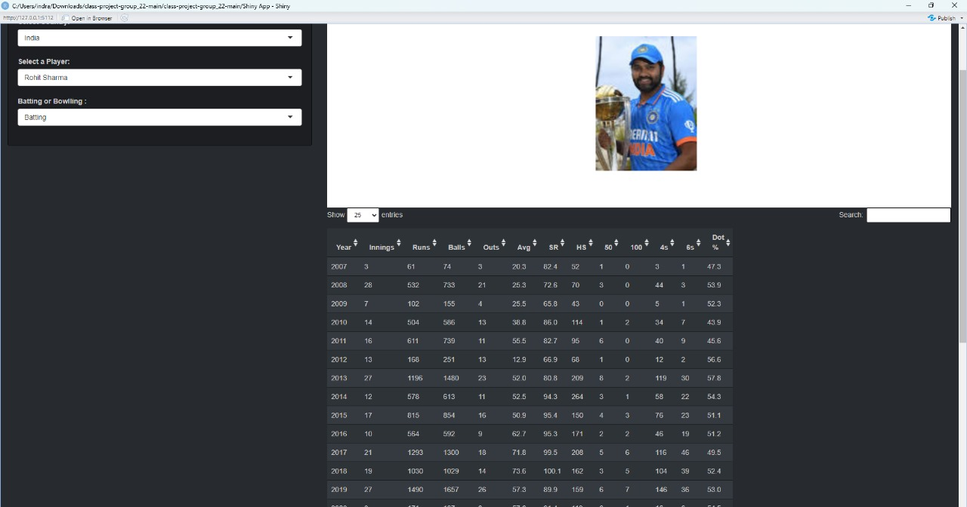
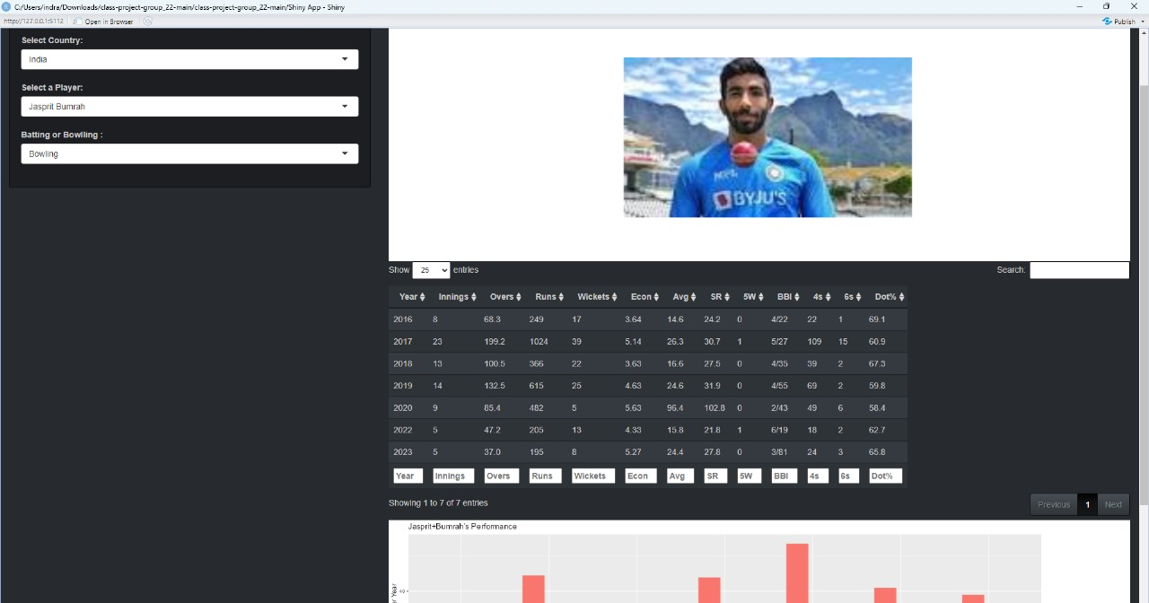
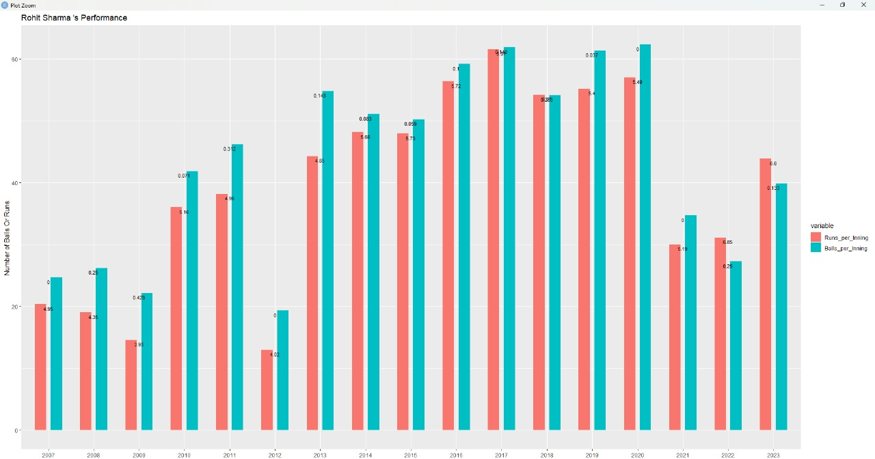
Retrieve individual player info throughout his entire career

Slide 5
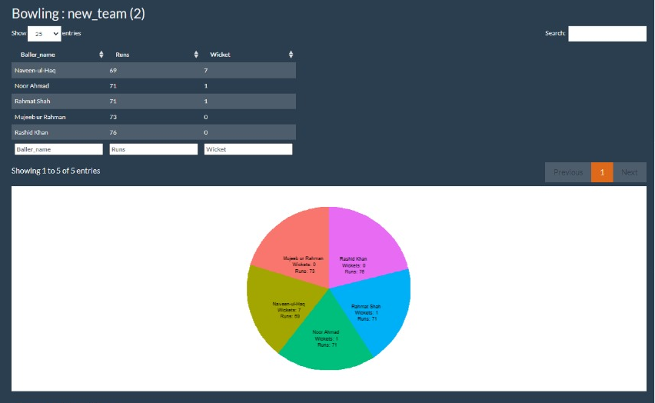
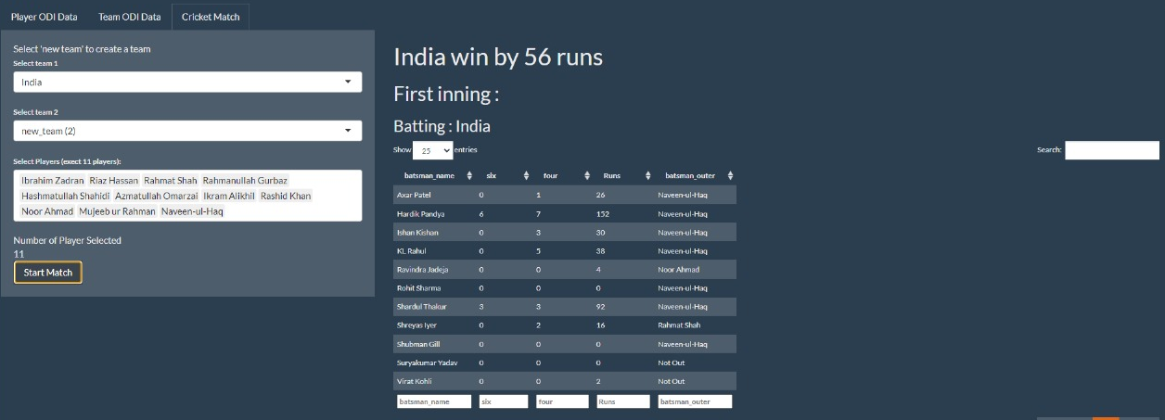
Run A live simulation of a cricket match with either default sides or a custom team of your favorite players!

Slide 6
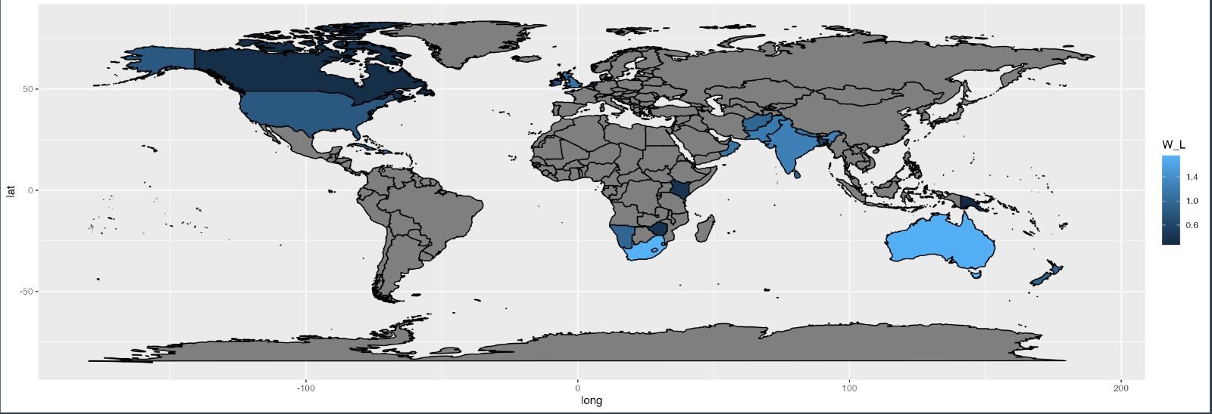
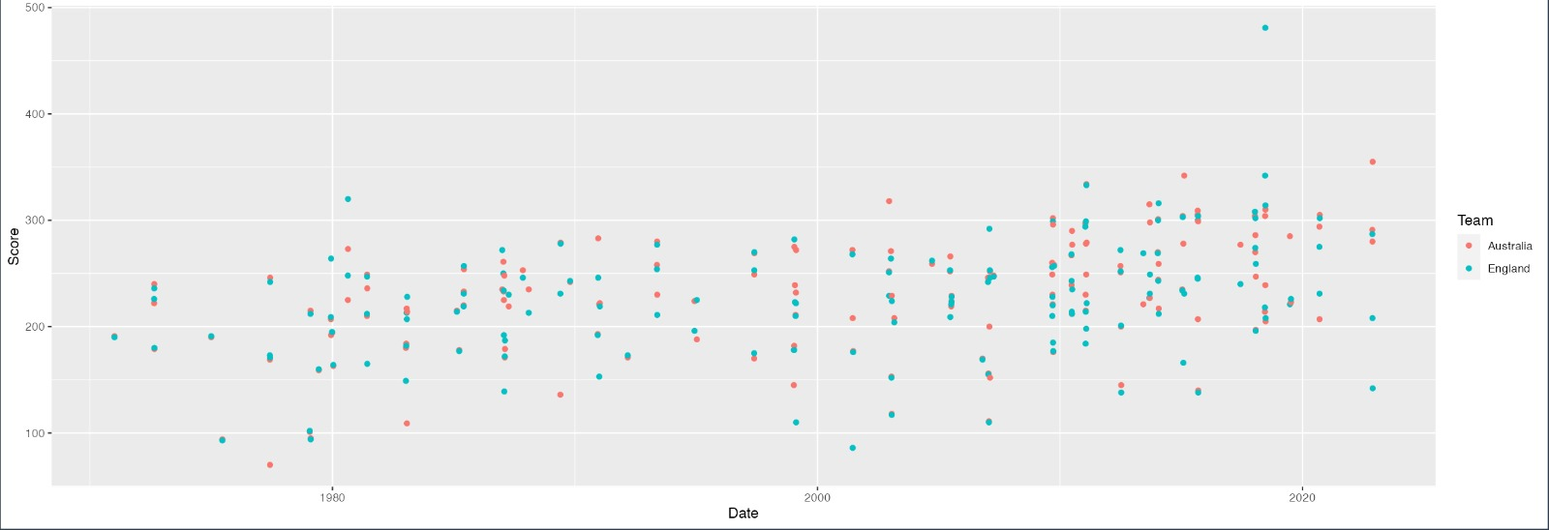
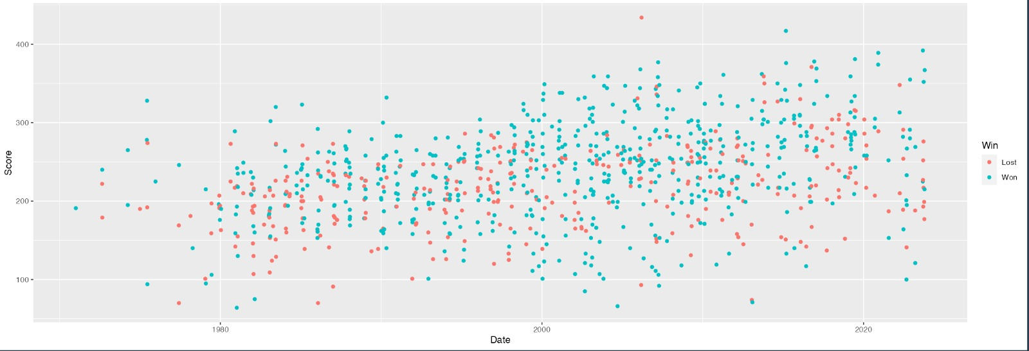
Win-Loss ratio of different countries participating in ODI World Cup
Get access to a summary of each previous encounter between two sides!
View a team's previous performance

Slide 7
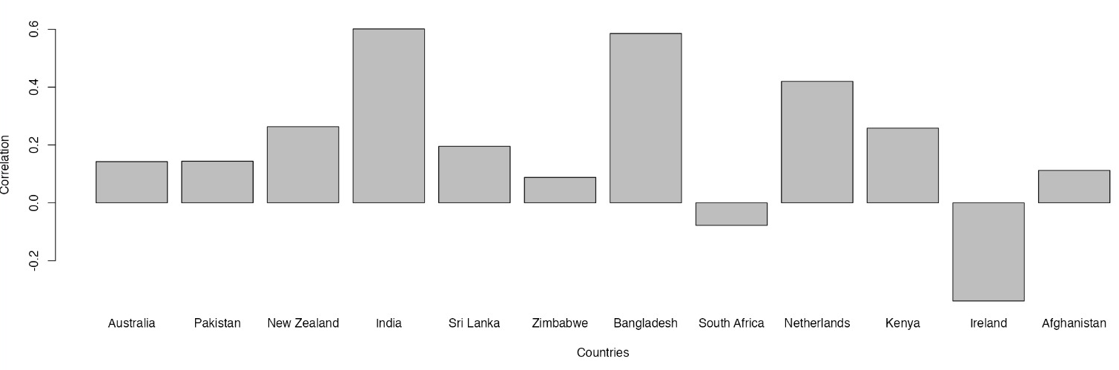
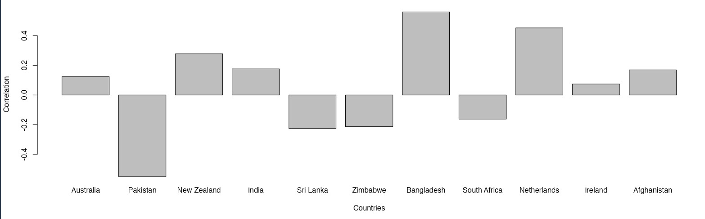
Some extra features of our app :-
Graph of Correlation

Slide 8
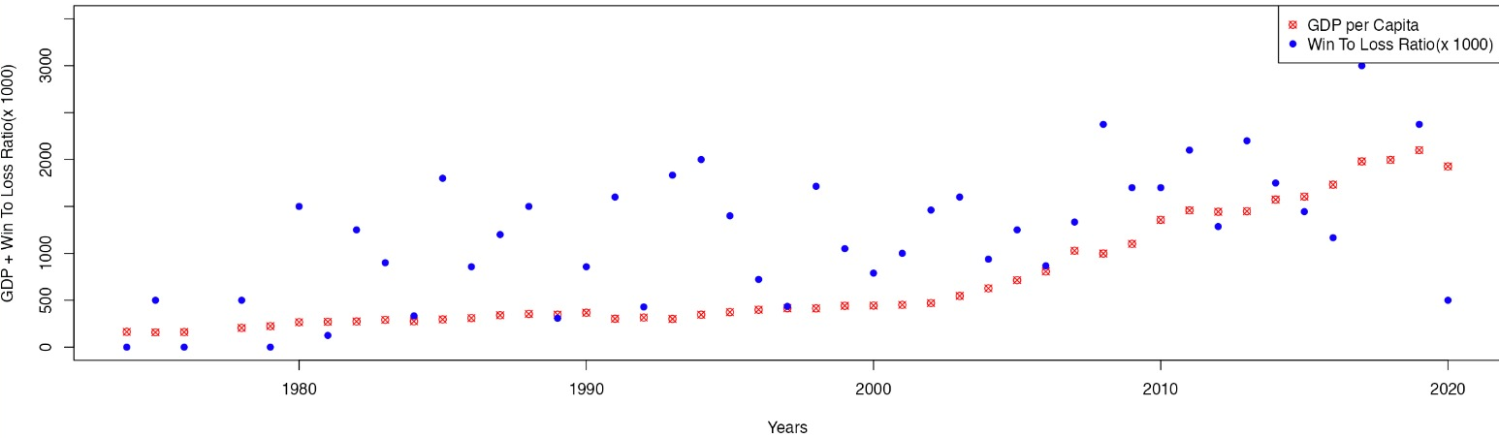
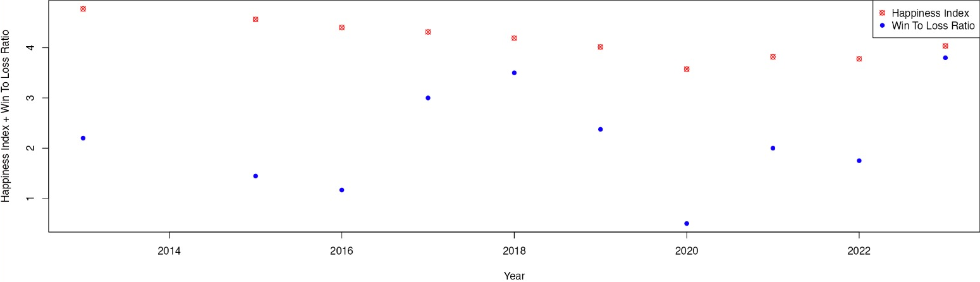
Relation between GDP per Capital , Happiness index vs Win - Loss ratio

Slide 9
References and links
https://www.espncricinfo.com/records/list-of-match-results-by-year-307851 (For ODI Match Data)
https://www.kaggle.com/datasets/simonaasm/world-happiness-index-by-reports-2013-2023/?select=World+Happiness+Index+by+Reports+2013-2023+with+nulls.csv (Happiness Index)
https://www.kaggle.com/datasets/zgrcemta/world-gdpgdp-gdp-per-capita-and-annual-growths?select=gdp_per_capita.csv (GDP Data)

Slide 10
THANK YOU

